Slide 1
Mastermind Codebreaker Game
MIPS Assembly Programming using QtSpim
Project No. : 20
Group No. :06
Indian Institute of Information Technology ,
Kalyani

Slide 2

Project Overview
4-Digit Secret
THE PROGRAM GENERATES A
SECRET FOUR DIGIT SEQUENCE
7 Attempts
THE PLAYER GETS A
MAXIMUM OF 7
ATTEMPTS
Feedback
EACH CASE
RECEIVES
POSITION & DIGIT
FEEDBACK
Implemented in MIPS Assembly
Executed and tested in QtSPIM
Game terminates with WIN or GAME OVER

Slide 3
Aim & Objectives
Design a 4-Digit sequence guessing game in MIPS
Assembly.
Generate a secret sequence and accept user guesses.
Validate the input and compare each guesses
with the secret.
Provide meaningful feedback after every attempt.
Limit the player to 7 attempts and display the final result.

Slide 4

Technologies & MIPS Concepts
MIPS Assembly
Core implementation
QtSPIM
Execution & testing
Registers
Temporary & Persistence
Values
Arrays
Secret and guess s
storage
Loops & Branches
Game flow & Decisions
Procedure & Stack
Modular logic &
Return address

Slide 5

System Workflow
Start
Display
Rules
Generate
Secret
Enter
Guess
Check
Result
Compare
Guess
Validate
Input
4 Correct Positions →Win
Otherwise → increase attempt counter → repeat until 7 attempts

Slide 6

Secret Code Generation
Pseudo-random generation using system time
System Time
Starting Seed
LCG
seed x 1103515245 + 12345
Modulo 10
digit = seed % 10
Repeat x4
Build secret code
seed = seed x 1103515245 + 12345
digit = seed mod 10

Slide 7

Guess Comparison Algorithm
1.Correct Position
Compare secret[i] with guess[i]. Finding Exact matches
2.Wrong Position
Search for matching digits at different positions
3.Not Present
4 – correct position – wrong position
The comparison procedure stores results in registers
used by the main game loop.

Slide 8

Example of Feedback
SECRET
6 1 2 1
GUESS
4 1 2 9
Correct Position
Wrong Position
Not Present
2
1
1

Slide 9
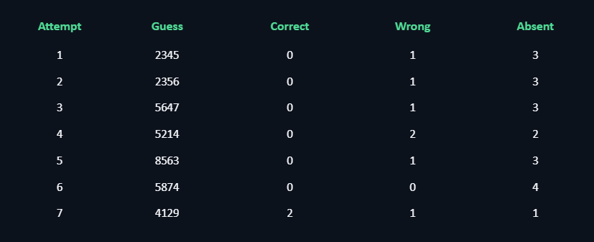
Program Execution Result
Secret Sequence
Allowed Attempts
Attempts Used
Status
6 1 2 1
7
7
GAME OVER

Slide 10

Conclusion & Future Scope
Conclusion
The project successfully implements
a 4-digit guessing game
in MIPS using QtSPIM, demonstrating registers,
loops, branching, arrays, procedures,
and stack operations.
Future Scope
Add different difficulty levels
Increase digits and attempts
Add score calculation
Develop a graphical user interface
Add a leaderboard
Improve the random code generation and game modes
Team Members
Angan Jana(1416) , Aayan Kumar Mondal(1402) , Aritra Dey Sarkar(1419) , Satyaki Banerjee(1482)

Slide 11


